Slide 1
The Semantic Web: Ontologies and OWL
CS646
Ian Horrocks and Alan Rector
University of Manchester
Manchester, UK
{arector|ihorrocks@cs.man.ac.uk}

Slide 2
Goals of the course
Understand the goals of the semantic web
  What’s it for
  What’s there now
  Where is it going
Understand the foundations for the semantic web
  Languages & logic
    Nodes and arcs – RDF and its relatives
    Description logics & Frames
    OWL and the Protégé/OWL tools
  Ontology problems
    Language and concepts
    Abstractions, time, space, parts & wholes,
    granularity & scale…
    Common idioms & common pitfalls

Slide 3

History of the Semantic Web
Web was “invented” by Tim Berners-Lee (amongst others), a physicist working at CERN
TBL’s original vision of the Web was much more ambitious than the reality of the existing (syntactic) Web:
TBL (and others) have since been working towards realising this vision, which has become known as the Semantic Web
  E.g., article in May 2001 issue of Scientific American…
“... a goal of the Web was that, if the interaction between person and hypertext could be so intuitive that the machine-readable information space gave an accurate representation of the state of people's thoughts, interactions, and work patterns, then machine analysis could become a very powerful management tool, seeing patterns in our work and facilitating our working together through the typical problems which beset the management of large organizations.”

Slide 4
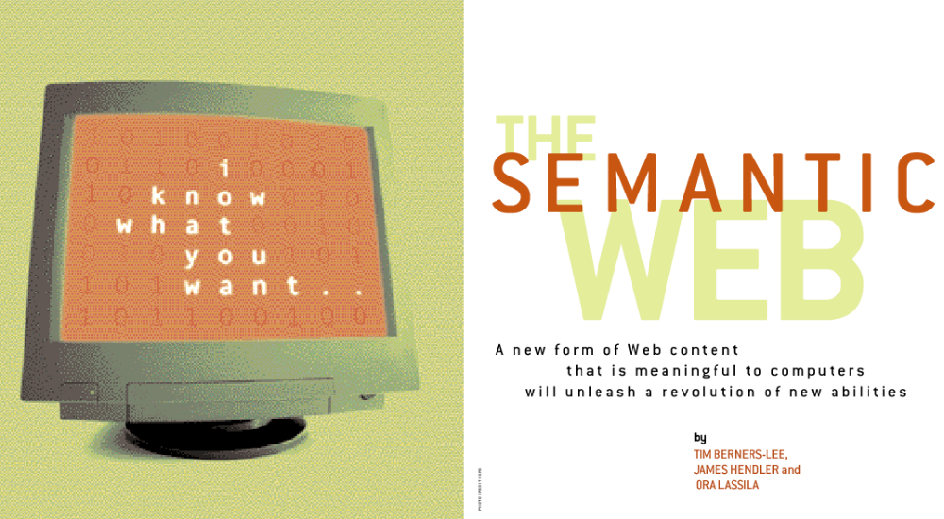
Scientific American, May 2001:
Realising the complete “vision” is too hard for now (probably)
But we can make a start by adding semantic annotation to web resources

Slide 5
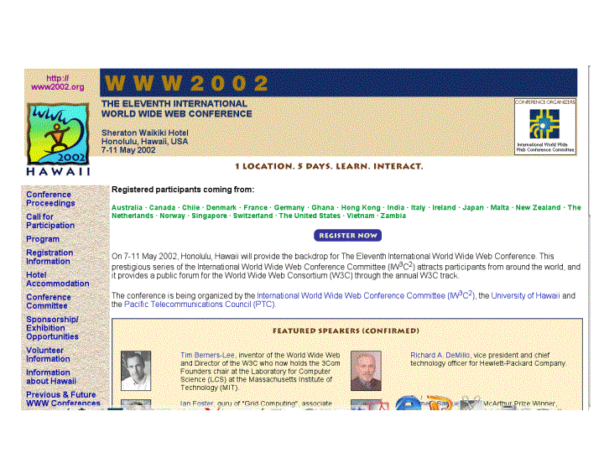
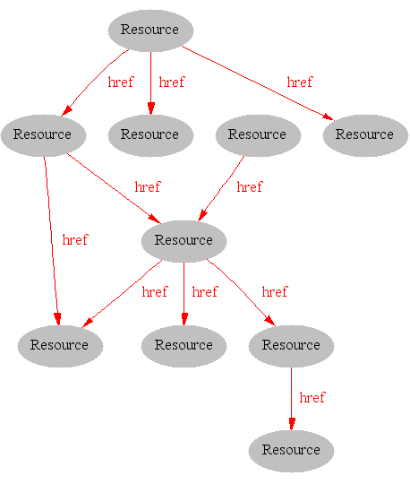
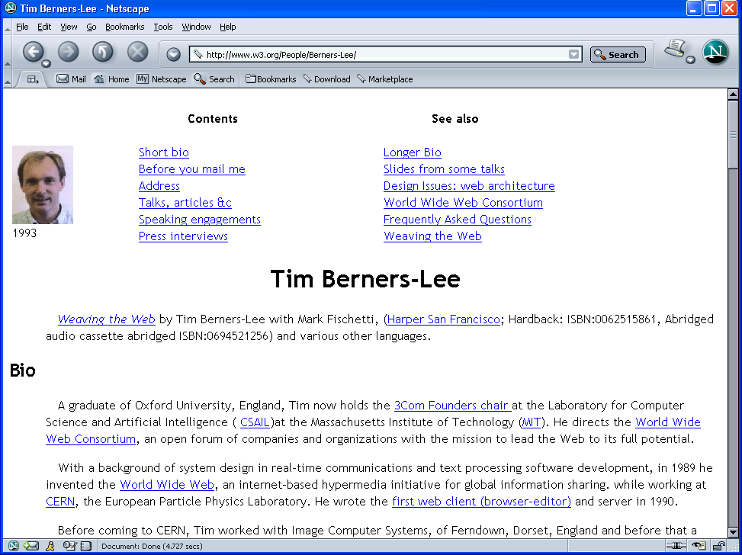
Where we are Today: the Syntactic Web
[Hendler & Miller 02]

Slide 6
The Syntactic Web is…
A place where computers do the presentation (easy) and people do the linking and interpreting (hard).
  A hypermedia, a digital library
    A library of documents called (web pages) interconnected by a hypermedia of links
  A database, an application platform
    A common portal to applications accessible through web pages, and presenting their results as web pages
  A platform for multimedia
    BBC Radio 4 anywhere in the world! Terminator 3 trailers!
  A naming scheme
    Unique identity for those documents
Why not get computers to do more of the hard work?
[Goble 03]

Slide 7
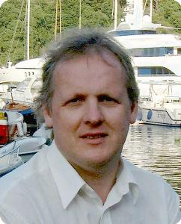

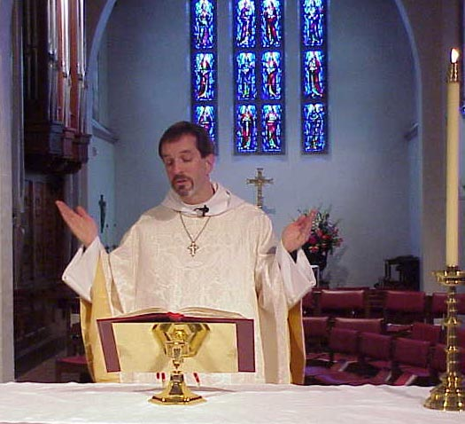
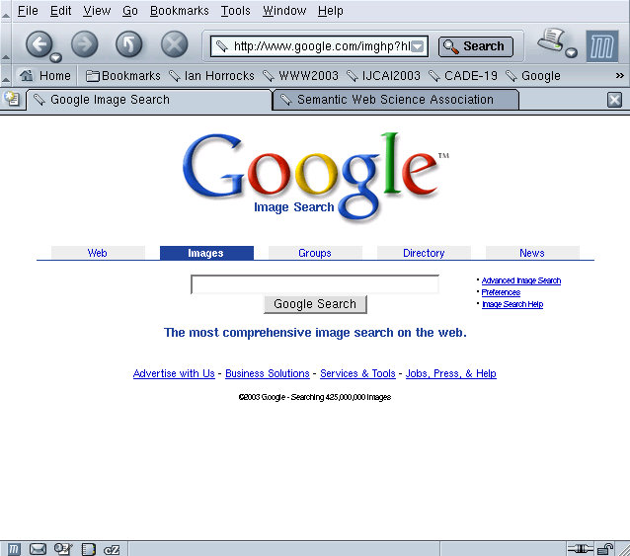
Hard Work using the Syntactic Web…
Find images of Steve Furber
Carole Goble
… Alan Rector…
Rev. Alan M. Gates, Associate Rector of the Church of the Holy Spirit, Lake Forest, Illinois

Slide 8
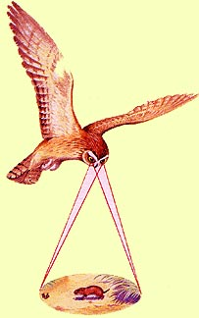
Impossible (?) using the Syntactic Web…
Complex queries involving background knowledge
  Find information about “animals that use sonar but are not either bats or dolphins”
Locating information in data repositories
  Travel enquiries
  Prices of goods and services
  Results of human genome experiments
Finding and using “web services”
  Visualise surface interactions between two proteins
Delegating complex tasks to web “agents”
  Book me a holiday next weekend somewhere warm, not too far away, and where they speak French or English
, e.g., Barn Owl

Slide 9
What is the Problem?
Consider a typical web page:
Markup consists of:
  rendering information (e.g., font size and colour)
  Hyper-links to related content
Semantic content is accessible to humans but not (easily) to computers…

Slide 10
What information can we see…
WWW2002
The eleventh international world wide web conference
Sheraton waikiki hotel
Honolulu, hawaii, USA
7-11 may 2002
1 location 5 days learn interact
Registered participants coming from
australia, canada, chile denmark, france, germany, ghana, hong kong, india, ireland, italy, japan, malta, new zealand, the netherlands, norway, singapore, switzerland, the united kingdom, the united states, vietnam, zaire
Register now
On the 7th May Honolulu will provide the backdrop of the eleventh international world wide web conference. This prestigious event …
Speakers confirmed
Tim berners-lee
Tim is the well known inventor of the Web, …
Ian Foster
Ian is the pioneer of the Grid, the next generation internet …

Slide 11
What information can a machine see…




  




…


…

…

Slide 12
Solution: XML markup with “meaningful” tags?
<name>
</name>
<location>
</location>
<date>  </date>
<slogan></slogan>
<participants>
</participants>
<introduction>
…
</introduction>
<speaker></speaker>
<bio></bio>…

Slide 13
But What About…
<conf>
</conf>
<place>
</place>
<date>  </date>
<slogan></slogan>
<participants>
</participants>
<introduction>
…
</introduction>
<speaker></speaker>
<bio>…

Slide 14
Still the Machine only sees…
<>
</>
<>
</>
<>  </>
<></>
<>
</>
<>
…
</>
<></>
<□></□>
<></>
<□></□>

Slide 15
Need to Add “Semantics”
External agreement on meaning of annotations
  E.g., Dublin Core for annotation of library/bibliographic information
    Agree on the meaning of a set of annotation tags
  Problems with this approach
    Inflexible
    Limited number of things can be expressed
Use Ontologies to specify meaning of annotations
  Ontologies provide a vocabulary of terms
  New terms can be formed by combining existing ones
    “Conceptual Lego”
  Meaning (semantics) of such terms is formally specified
  Can also specify relationships between terms in multiple ontologies

Slide 16
Ontology: Origins and History
Ontology in Philosophy
  a philosophical discipline—a branch of philosophy that
  deals with the nature and the organisation of reality
Science of Being (Aristotle, Metaphysics, IV, 1)
Tries to answer the questions:
    What characterizes being?
    Eventually, what is being?
How should things be classified?

Slide 17


Ontology in Linguistics
Concept
Relates to
activates
Form
Referent
Stands for
“Tank“
?
[Ogden, Richards, 1923]

Slide 18
Classification: An Old Problem
“On those remote pages it is written that animals are divided into:
a. those that belong to the Emperor
b. embalmed ones
c. those that are trained
d. suckling pigs
e. mermaids
f. fabulous ones
g. stray dogs
h. those that are included in this classification
i. those that tremble as if they were mad
j. innumerable ones
k. those drawn with a very fine camel's hair brush
l. others
m. those that have just broken a flower vase
n. those that resemble flies from a distance"
From The Celestial Emporium of Benevolent Knowledge, Borges

Slide 19
Ontology in Computer Science
An ontology is an engineering artifact:
  It is constituted by a specific vocabulary used to describe a certain reality, plus
  a set of explicit assumptions regarding the intended meaning of the vocabulary.
    Almost always including how concepts should be classified
Thus, an ontology describes a formal specification of a certain domain:
  Shared understanding of a domain of interest
  Formal and machine manipulable model of a domain of interest
“An explicit specification of a conceptualisation” [Gruber93]

Slide 20
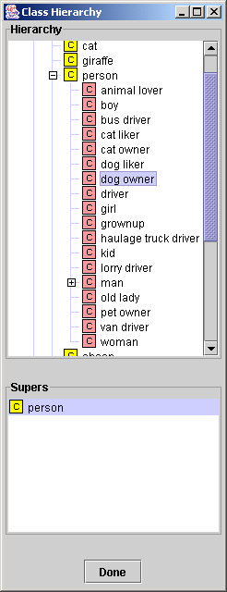
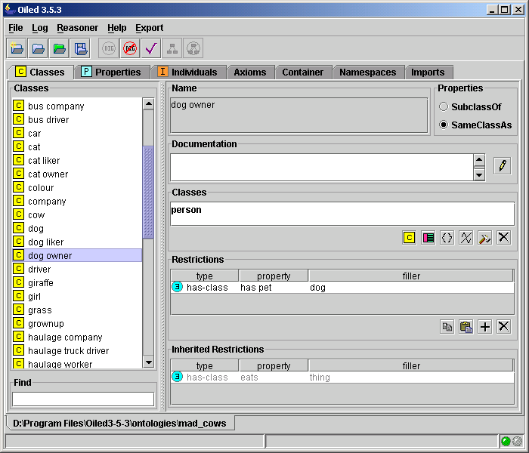
Example Ontology

Slide 21
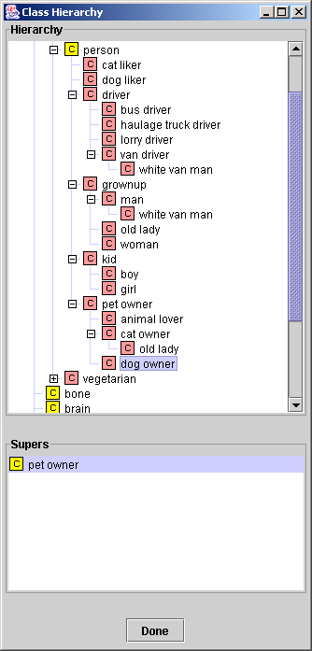
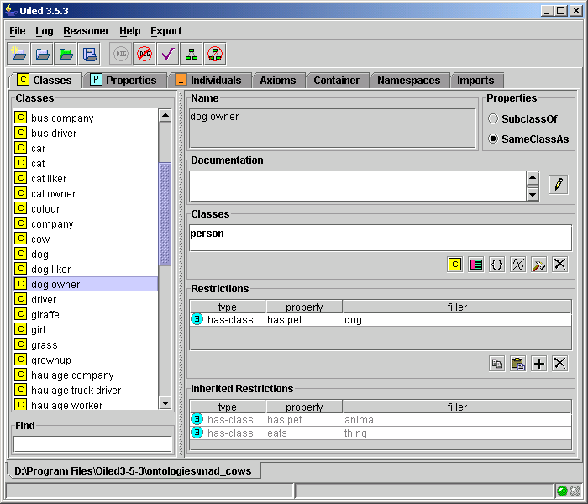
Ontology Classified Logically

Slide 22
Where else are ontologies used?
Bioinformatics
  The Gene Ontology
  The Protein Ontology (MGED)
Medicine
  “The terminology wars”
Linguistics
Database integration
User interface design
Fractal Indexing

Slide 23
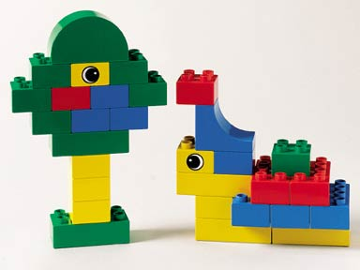
Ontologies as Conceptual Lego
“Manchester Postgraduate Student taking CS626”
“Hand which is
anatomically
normal”

Slide 24
User Interfaces using conceptual Lego
Structured Data Entry
File Edit Help
FRACTURE SURGERY
Reduction
Fixation
Fixation
Open
Open
Closed
Femur
Tibia
Fibula
Ankle
More...
Femur
Humerus
Radius
Ulna
Wrist
More...
Left
Right
Left
Shaft
Neck
Neck
Gt Troch
More...
Fixation of open fracture of neck of left femur

Slide 25
Ian Take Over Here?

Slide 26
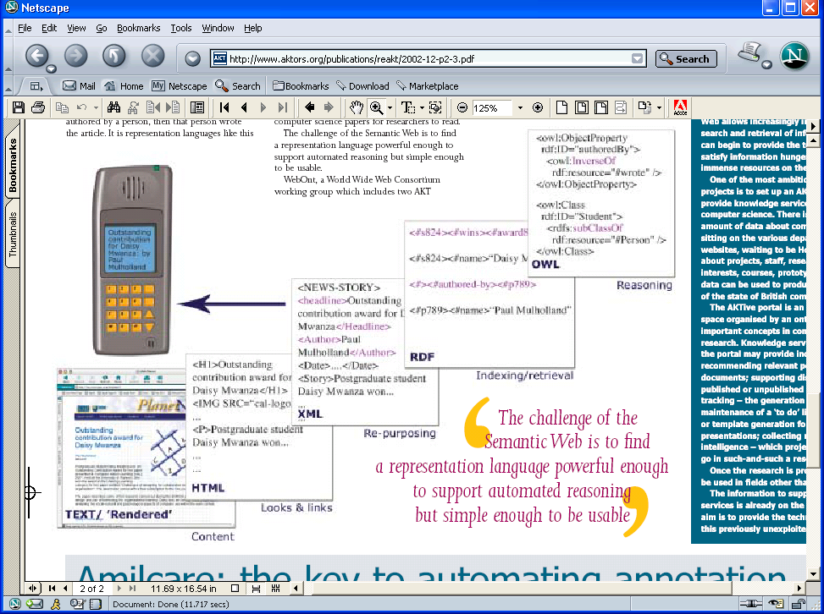
[AKT 2003]

Slide 27
So why is it hard?
Ontology languages are tricky
  “All tractable languages are useless;
  all useful languages are intractable”
Ontologies are tricky
  People do it too easily;
  People are not logicians
    Intuitions hard to formalise
The evidence
  The problem has been about for 3000 years
    But now it matters!
      The semantic web means knowledge representation matters
The goal of the course
  Make it easier

Slide 28
Structure of an Ontology
Ontologies typically have two distinct components:
Names for important concepts in the domain
  Elephant is a concept whose members are a kind of animal
  Herbivore is a concept whose members are exactly those animals who eat only plants or parts of plants
  Adult_Elephant is a concept whose members are exactly those elephants whose age is greater than 20 years
Background knowledge/constraints on the domain
  Adult_Elephants weigh at least 2,000 kg
  All Elephants are either African_Elephants or Indian_Elephants
  No individual can be both a Herbivore and a Carnivore

Slide 29
Tools and Services
We need to provide tools and services to help users to:
  Design and maintain high quality ontologies, e.g.:
    Meaningful — all named classes can have instances
    Correct — captured intuitions of domain experts
    Minimally redundant — no unintended synonyms
    Richly axiomatised — (sufficiently) detailed descriptions
  Store (large numbers) of instances of ontology classes, e.g.:
    Annotations from web pages
  Answer queries over ontology classes and instances, e.g.:
    Find more general/specific classes
    Retrieve annotations/pages matching a given description
  Integrate and align multiple ontologies

Slide 30
OWL as (Description) Logic
XMLS datatypes as well as classes in 8P.C and 9P.C
  E.g., 9hasAge.nonNegativeInteger
Arbitrarily complex nesting of constructors
  E.g., Person u 8hasChild.(Doctor t 9hasChild.Doctor)

Slide 31
Formal (DL) Semantics
Mapping OWL to equivalent DL (SHOIN(D_{n})):
  Facilitates provision of reasoning services (using DL systems)
  Provides well defined semantics
DL semantics defined by interpretations: I = (Δ^{I}, ¢^{I}), where
  Δ^{I} is the domain (a non-empty set)
  ¢^{I} is an interpretation function that maps:
    Concept (class) name A ! subset A^{I} of Δ^{I}
    Role (property) name R ! binary relation R^{I} over Δ^{I}
    Individual name i ! i^{I} element of Δ^{I}

Slide 32
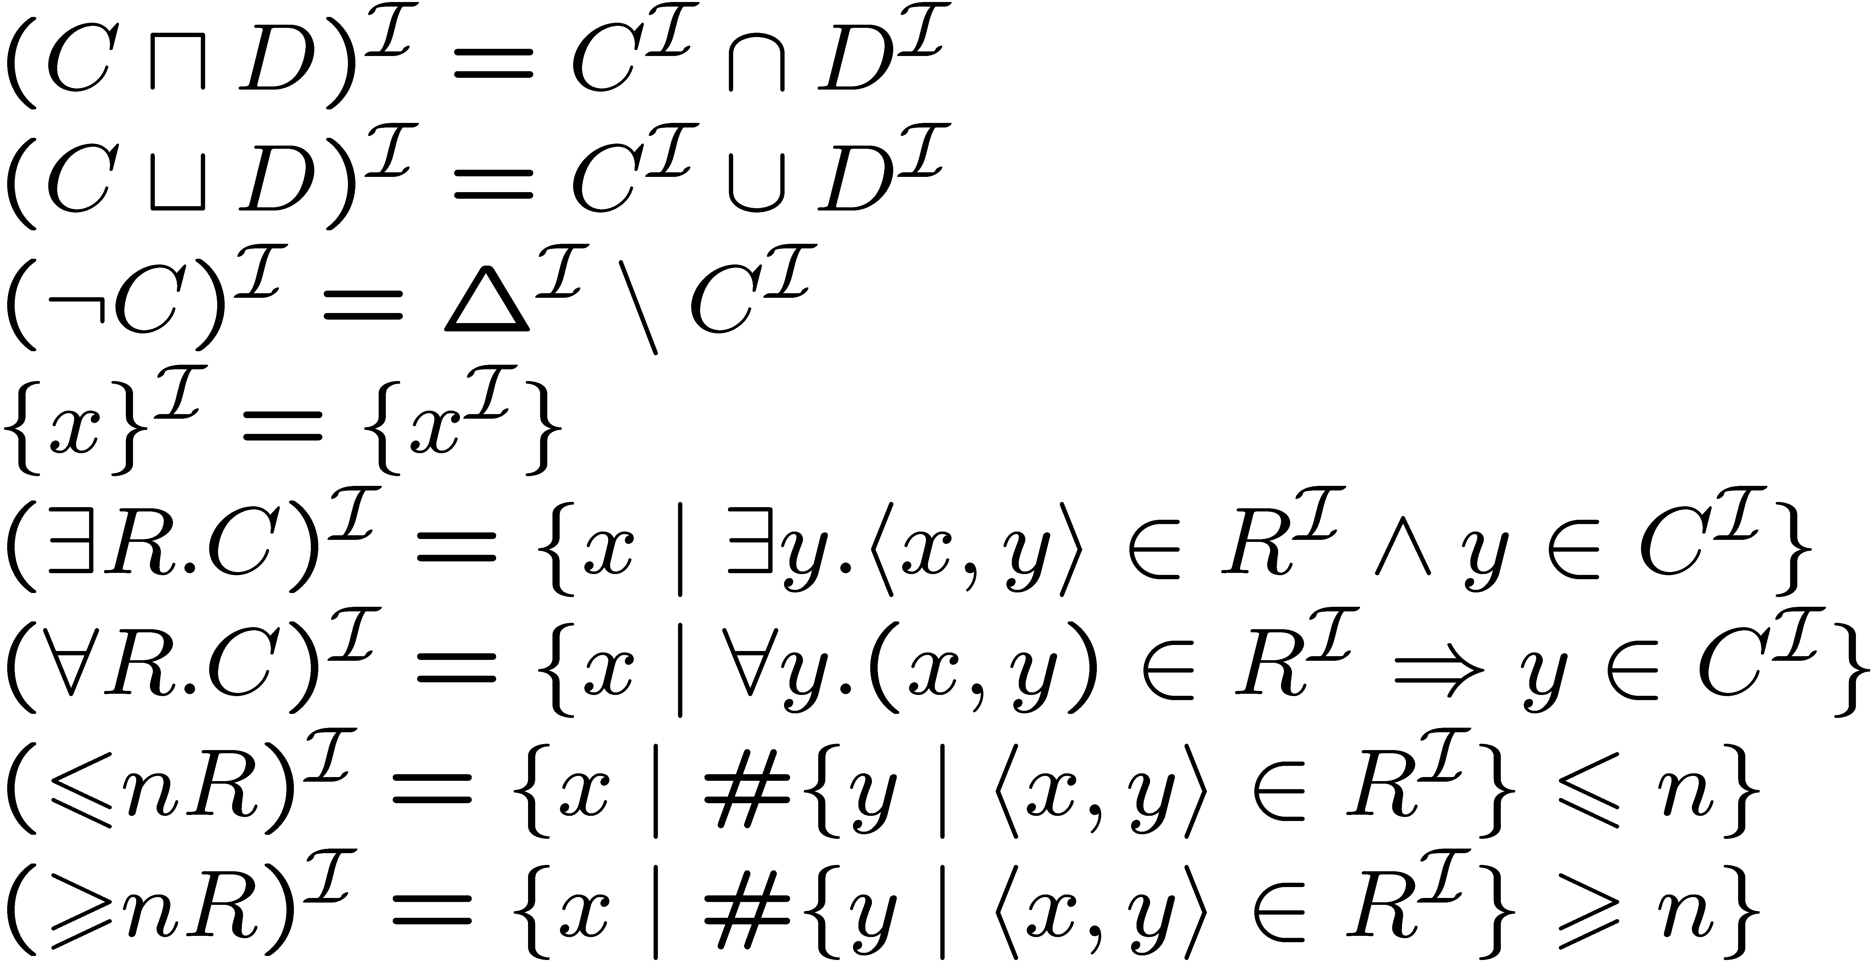
Interpretation function ¢^{I} extends to concept expressions in the obvious way, i.e.:

Slide 33
Ontologies as DL Knowledge Bases
An OWL ontology maps to a DL Knowledge Base K = hT , Ai
  T (Tbox) is a set of axioms of the form:
    C v D, C ´ D (concept inclusion/equivalence)
    R v S, R ´ S (role inclusion/equivalence)
    R⁺ v R (role transitivity)
  A (Abox) is a set of axioms of the form
    x 2 D (concept instantiation)
    hx,yi 2 R (role instantiation)
Two sorts of Tbox axioms often distinguished
  “Definitions”
    C v D or C ´ D where C is a concept name
  General Concept Inclusion axioms (GCIs)
    C v D where C in an arbitrary concept

Slide 34
Knowledge Base Semantics
An interpretation I satisfies (models) an axiom A (I ² A):
  I ² C v D iff C^{I} µ D^{I} I ² C ´ D iff C^{I} = D^{I}
  I ² R v S iff R^{I} µ S^{I} I ² R ´ S iff R^{I} = S^{I}
  I ² R⁺ v R iff (R^{I})⁺ µ R^{I}
  I ² x 2 D iff x^{I} 2 D^{I}
  I ² hx,yi 2 R iff (x^{I},y^{I}) 2 R^{I}
I satisfies a Tbox T (I ² T ) iff I satisfies every axiom A in T
I satisfies an Abox A (I ² A) iff I satisfies every axiom A in A
I satisfies a KB K (I ² K) iff I satisfies both T and A

Slide 35
Services as Reasoning
Knowledge is meaningful (classes can have instances)
  C is satisfiable w.r.t. K iff there exists some model I of K s.t. C^{I} ≠ ;
Knowledge is correct (captures intuitions)
  C subsumes D w.r.t. K iff for every model I of K, C^{I} µ D^{I}
Knowledge is minimally redundant (no unintended synonyms)
  C is equivallent to D w.r.t. K iff for every model I of K, C^{I} = D^{I}
Querying knowledge
  x is an instance of C w.r.t. K iff for every model I of K, x^{I} 2 C^{I}
  hx,yi is an instance of R w.r.t. K iff for, every model I of K, (x^{I},y^{I}) 2 R^{I}
All above problems reducible to Knowledge Base consistency
  A KB K is consistent iff there exists some model I of K
KB consistency reducible to concept consistency

Slide 36
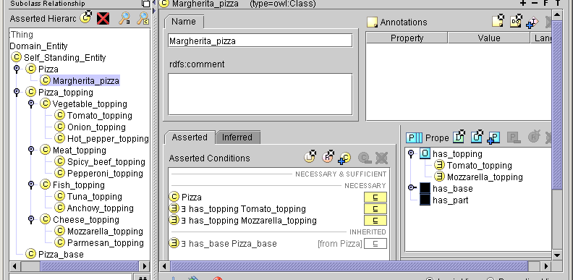
Results for Margherita Pizza
someValuesFrom
restrictions
Properties
subpane showing
alternative ‘frame’
view
What it means
  All Margherita_pizzas (amongst other things)
    Are Pizzas
    have_topping some Tomato_topping
    have_topping some Mozzarella_topping
      & because they are Pizzas
      have_base some Pizza_base

Slide 37
What it
Means
Pizza_base
Pizza_
toppings
aPB₁
aPB₂
aPB_{j}
…
Mozzarella_Toppings
aMZ₁
aMZ₂
Pizzas
aMZ₃
aMZ₄
…
Margherita_pizzas
aMP₁
aMP_{i}
Tomato_
toppingss
aMP₂
aT₁
aT_{k}
aT₂
aT₃
…
aT₄

Slide 38
DL Reasoning
Tableau algorithms used to test satisfiability (consistency)
Try to build a tree-like model I of the input concept C
Decompose C syntactically
  Apply tableau expansion rules
  Infer constraints on elements of model
Tableau rules correspond to constructors in logic (u, t etc)
  Some rules are nondeterministic (e.g., t, 6)
  In practice, this means search
Stop when no more rules applicable or clash occurs
  Clash is an obvious contradiction, e.g., A(x), : A(x)
Cycle check (blocking) may be needed for termination
C satisfiable iff rules can be applied such that a fully expanded clash free tree is constructed

Slide 39
Highly Optimised Implementation
Naive implementation leads to effective non-termination
Modern systems include MANY optimisations
Optimised classification (compute partial ordering)
  Use enhanced traversal (exploit information from previous tests)
  Use structural information to select classification order
Optimised subsumption testing (search for models)
  Normalisation and simplification of concepts
  Absorption (rewriting) of general axioms
  Davis-Putnam style semantic branching search
  Dependency directed backtracking
  Caching of satisfiability results and (partial) models
  Heuristic ordering of propositional and modal expansion
  …

Slide 40
Brief History of Formal KR (1)
Early history:
  Frege, Cantor, Russell, Goedel, Turing,…
Informal Semantic Networks and Frames (pre 1980)
  Wood: What’s in a Link; Brachman: What IS-A is and IS-A isn’t.
First Formalisation (1980)
  Bobrow: KRL Brachman: KL-ONE
All useful systems are intractable (1983)
  Brachman & Levesque: A fundamental tradeoff
    Hybrid systems: T-Box and A-Box
All tractable systems are useless (1987-1990)
  Doyle and Patel: Two dogmas of Knowledge Representation

Slide 41
Brief History of Formal KR (2)
‘Maverick’ incomplete/hybrid/intractable systems (1985-90)
  LOOM, Cyc, GRAIL…
The German School: Description Logics (1988-98)
  Baader and colleagues
  Introduction of complete and decidable algorithms based on tableaux methods (KRIS 1991-1992)
  Catalogue of complexity and expressiveness of combinations of features
Optimised systems for practical cases (1996-)
  Understanding of distribution of ‘hard’ cases
    Competition for performance of classifiers for expressive systems (1998)
  Proofs of equivalence to modal logics and SAT problems

Slide 42
Meanwhile related developments
Object oriented programming
  Simula, Smalltalk, … Java
Object oriented design
  Entity relationship diagrams… UML
SGML, HTML, XML and the web
  Including RDF and Topic Maps
Our goal, by the end of the course…
  You should be able to understand the similarities and differences amongst the related methodologies
  Understand the logical foundations
  Have the vocabulary and basic skills to know when and how to use modern ontology tools
    … and when not to!

Slide 43
OWL examples
DL examples of underlying formalism
I’ve stuck some pizza bits in next and could get others – ignore or use as you see fit.

Slide 44
Practicalities
Course dates: 22 Nov – 11 Dec
Teaching: Week of 29 November
Preparation week:
On line tutorials using Protége-OWL –
  Textbook quality tutorial at www.co-ode.org
Reading from Description Logic Handbook and key articles
(to be distributed)
Course week:
Mixed lecture and lab:
  Ontology Formalisms: Ian Horrocks
  Ontology Applications: Alan Rector
Post course week:
  Exercises plus micro project developing/critiquing an ontology

Slide 45
Practicalities
Assessment
  40% exam
  30% lab exercises in course week
  30% post course exercises and micro project
Lab tools (downloadable)
  Protege – http://protege.stanford.edu
  CO-ODE extras – http://www.co-ode.org
Texts / Reading
  Web site: http://www.cs.man.ac.uk/~horrocks/Teaching/cs646/
  OWL tutorial – from http://www.co-ode.org
  Articles to be distributed
  Description Logic Handbook Chap 2
  Ernest Davies Representations of Commonsense Knowledge, Morgan Kaufman 1990

Slide 46
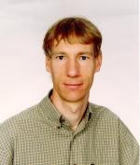
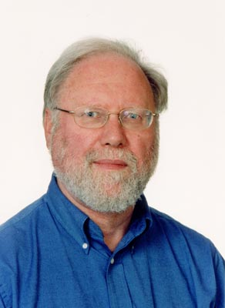
Who are We?
Ian Horrocks:
  Member of the W3C WebOnt committee that has defined the OWL language
  Developer of FaCT, Oil, and other DL reasoners
  Leading member of the semantic web community
  A “neat”
Alan Rector:
  Leader of Health Informatics Group,
  User of ontologies in medical terminologies and applications
  Leader of CO-ODE project to combine Protégé and OWL/OilEd
  Member of the W3C Semantic Web Best Practices and Deployment Working Group
  A “scruffy”

Slide 47
www.cs.man.ac.uk/~rector/kr-intro.ppt

